Slide 1
Data Scientist
in Twitter
By
Jianxing MA
Xinglin HUANG
Yichen WANG
Zhaochen ZHAN

Slide 2
Problem Statement
What factors contribute to the influence of data scientist twitter community?
Who is more influential?
What is their hot topic?
Do they have different small groups or clusters?
Who is benefit:
Everyone who is interested in data science will have insight of those professional world in twitter.
Understand the trend or state of art information.
The challenges:
how to identify real data sciencetist? how to interpret different communities?
how to interpret the results of different influence?

Slide 3
Design
Data Collection
Twitter API,Tweepy
Data Cleaning
Combine dataset,
Add weights attribute
Reduce Stop word
Data Analysis
Keyword frequency
Sentimental analysis
IBM Bluemix Personality Insights
Gephi

Slide 4
Flowchart
Betweenness
Centrality
Data Scientist
Follower
Data
Scientist
Social Network
PageRank
Python, twitter API
Bio: Data Scientist
Bio: Data Analyst
Gephi
Community Detection

Slide 5
Dataset Description
75 Data scientist
screen name as unique identifier
Data scientist => followers(1:M)
2,500 on average
181,694 records
Top 10 betweenness data scientist
Top 10, Bottom 10 scientist in pagerank
763 records
297 records

Slide 6
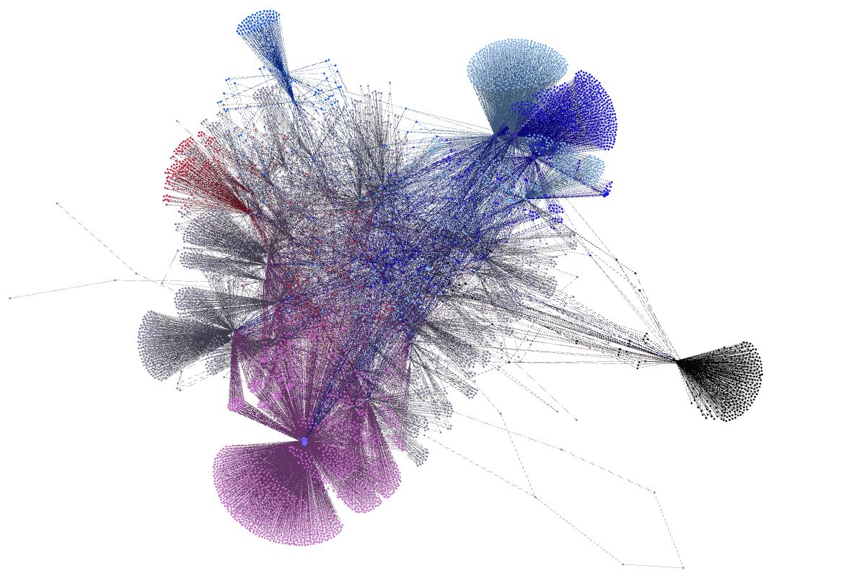

Slide 7
Results

Slide 8
Part A: Betweenness Centrality
Betweenness
Centrality
Data Scientist
Follower
Data
Scientist
Social Network
PageRank
Community Detection
Data Scientist

Slide 9
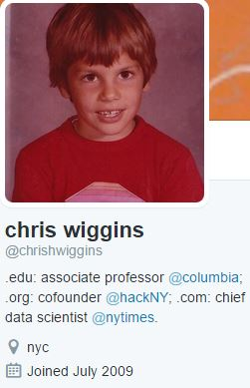
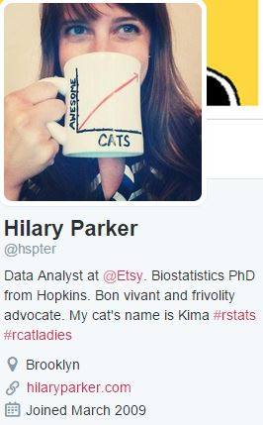
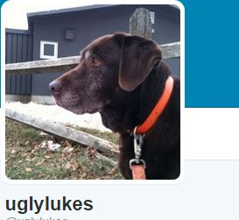
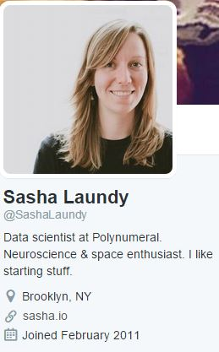
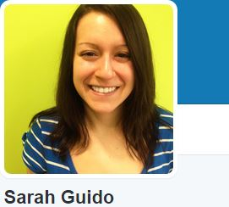
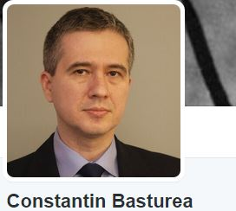
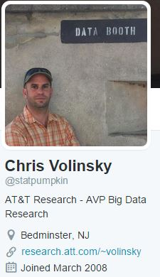
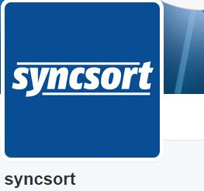
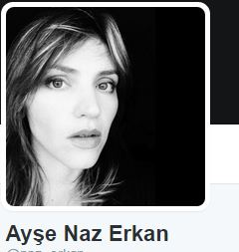
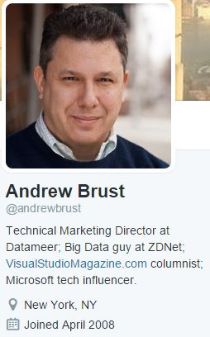
Betweenness Centrality: Top 10

Slide 10
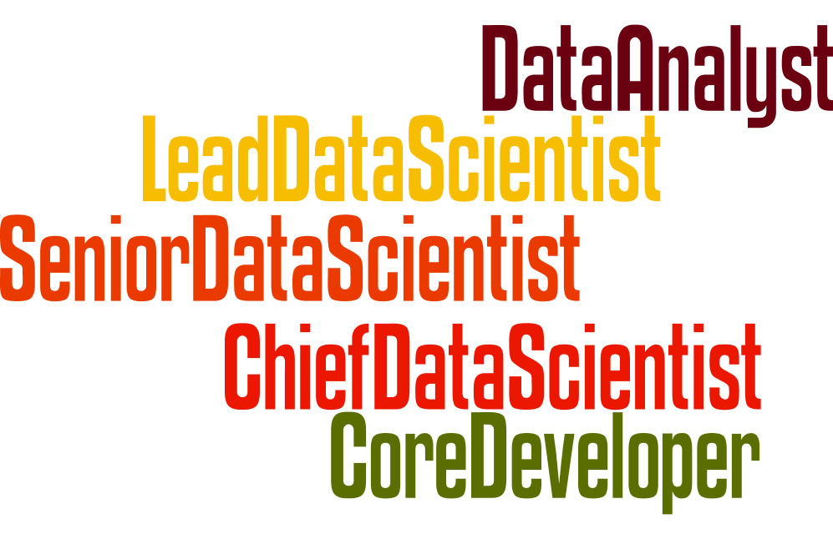
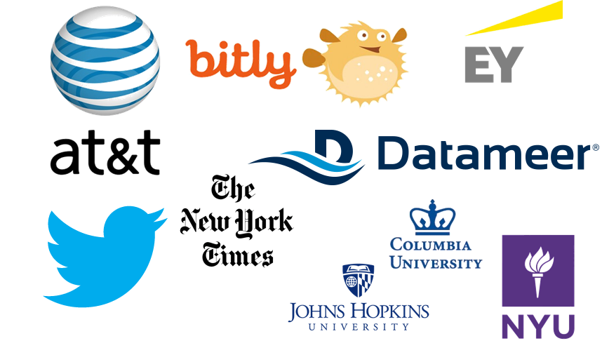
Betweenness Centrality: Top 10
It’s a tightly woven Data Science community

Slide 11
Part B: Page Rank
Betweenness
Centrality
Data Scientist
Follower
Data
Scientist
Social Network
PageRank
Community Detection

Slide 12
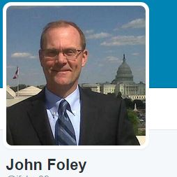
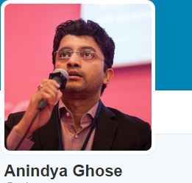
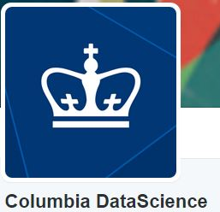
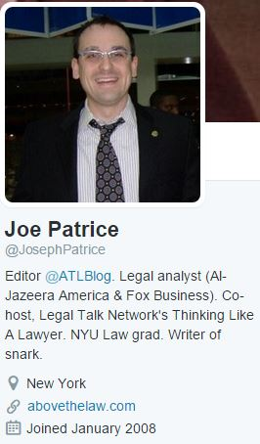
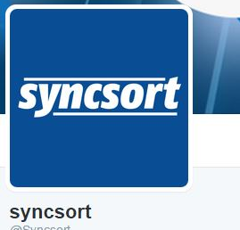
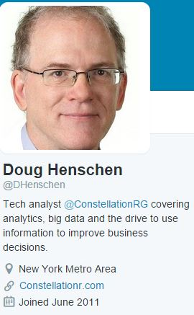
Page Rank: Top 10

Slide 13
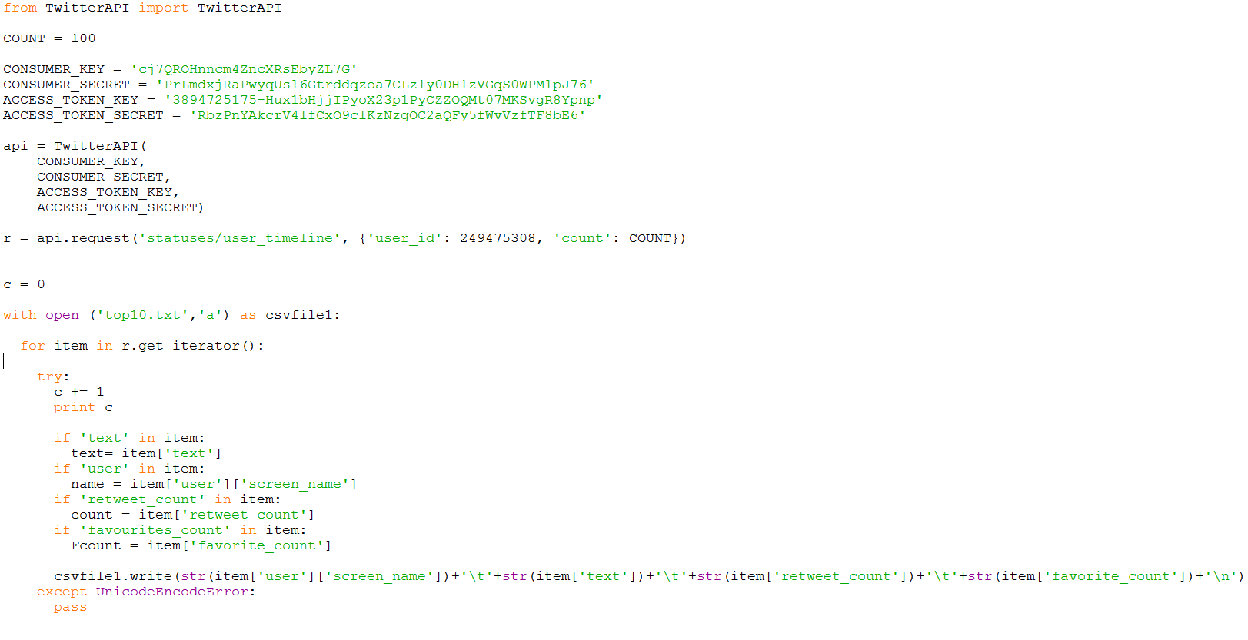
Analyzing PageRank Results
Crawled 100 tweets from each of the top 10 and bottom 10 nodes.

Slide 14
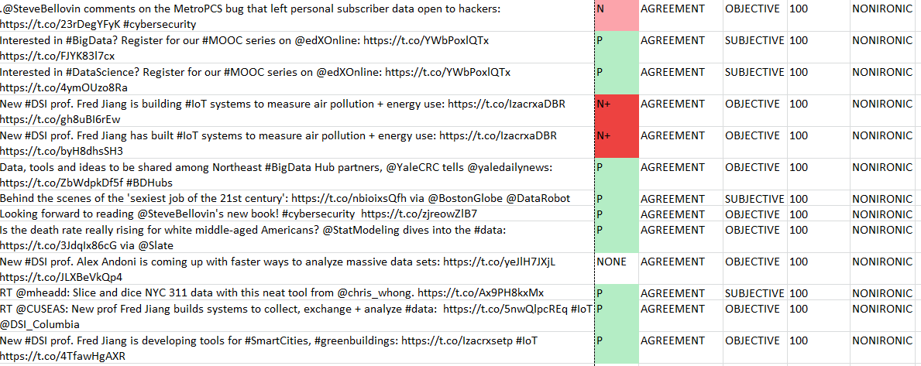
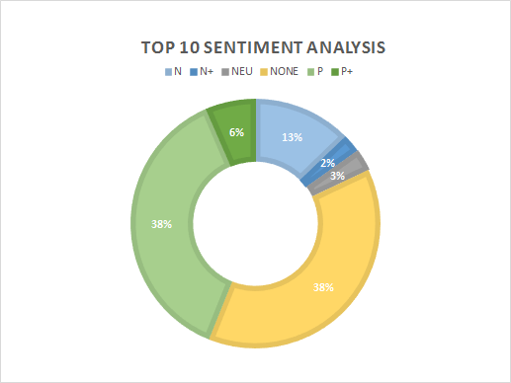
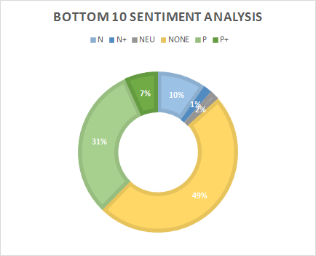
Sentiment Analysis on Tweets
Sentiment analysis on tweets from both groups.
Result: 40% positive, 13% negative for both groups. Cannot differentiate two groups based on sentiment analysis.

Slide 15
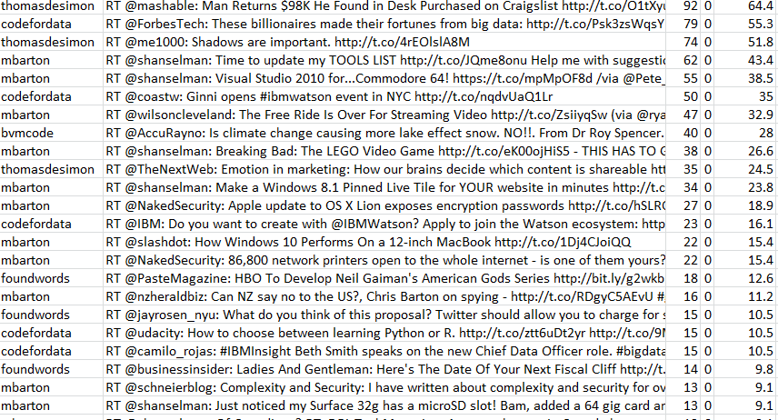
Methodology of Tweet Content Analysis
Weigh each tweet based on retweet count and favorite count.
Weight = 0.7*retweet count +0.3* favorite count

Slide 16
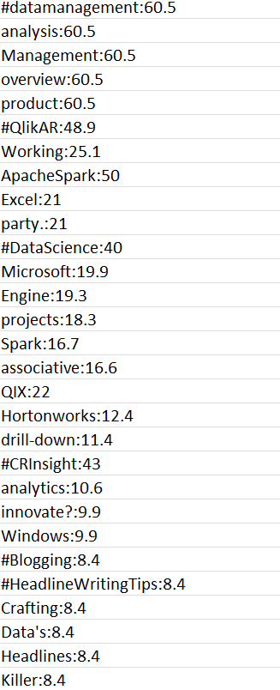
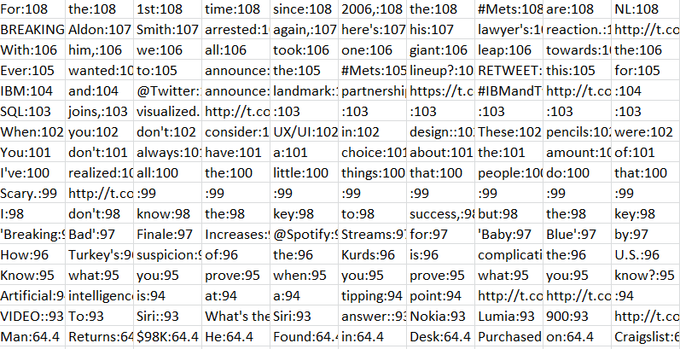
Tweet data filtering
We applied the weight for the tweet to each word within the tweet
Put the weighted keyword list into wordle.net
Generate wordcloulds for both groups

Slide 17
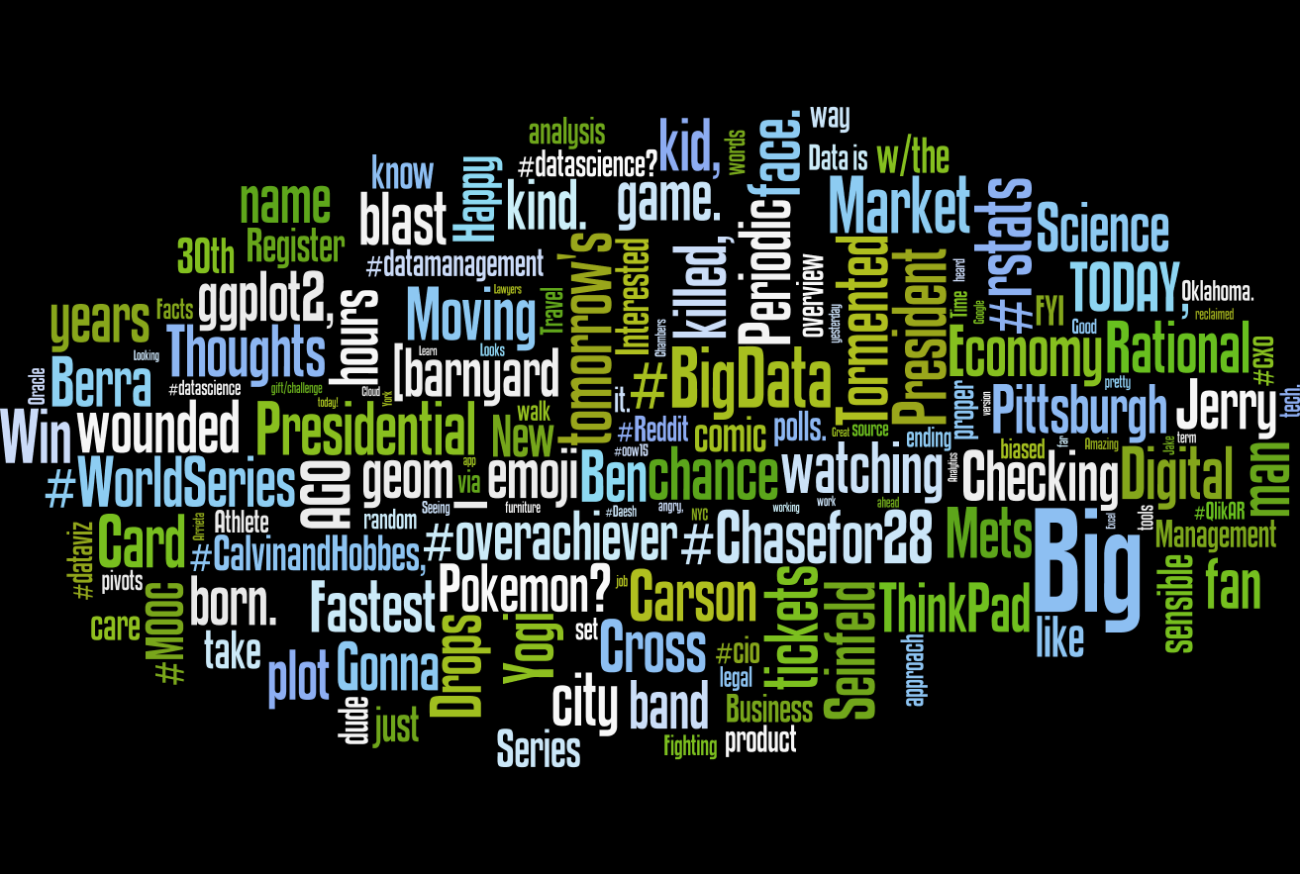
Top 10 pagerank profiles
Key words:
BigData
Market
Science
Presidential
ThinkPad
ggplot2
Digital
Rstats

Slide 18
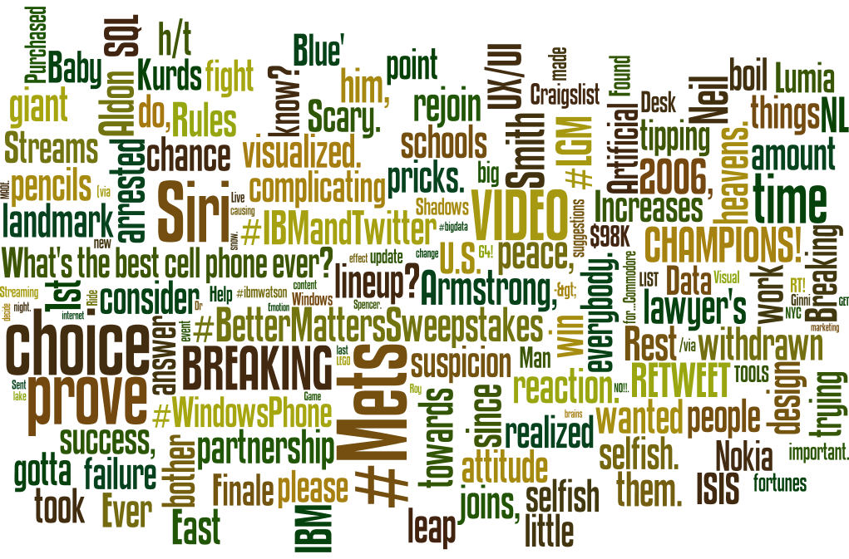
Bottom 10 pagerank profiles
Keywords:
Mets
Champions
Video
Siri

Slide 19
Part C: Community Detection
Betweenness
Centrality
Data Scientist
Follower
Data
Scientist
Social Network
PageRank
Community Detection
Data Scientist

Slide 20
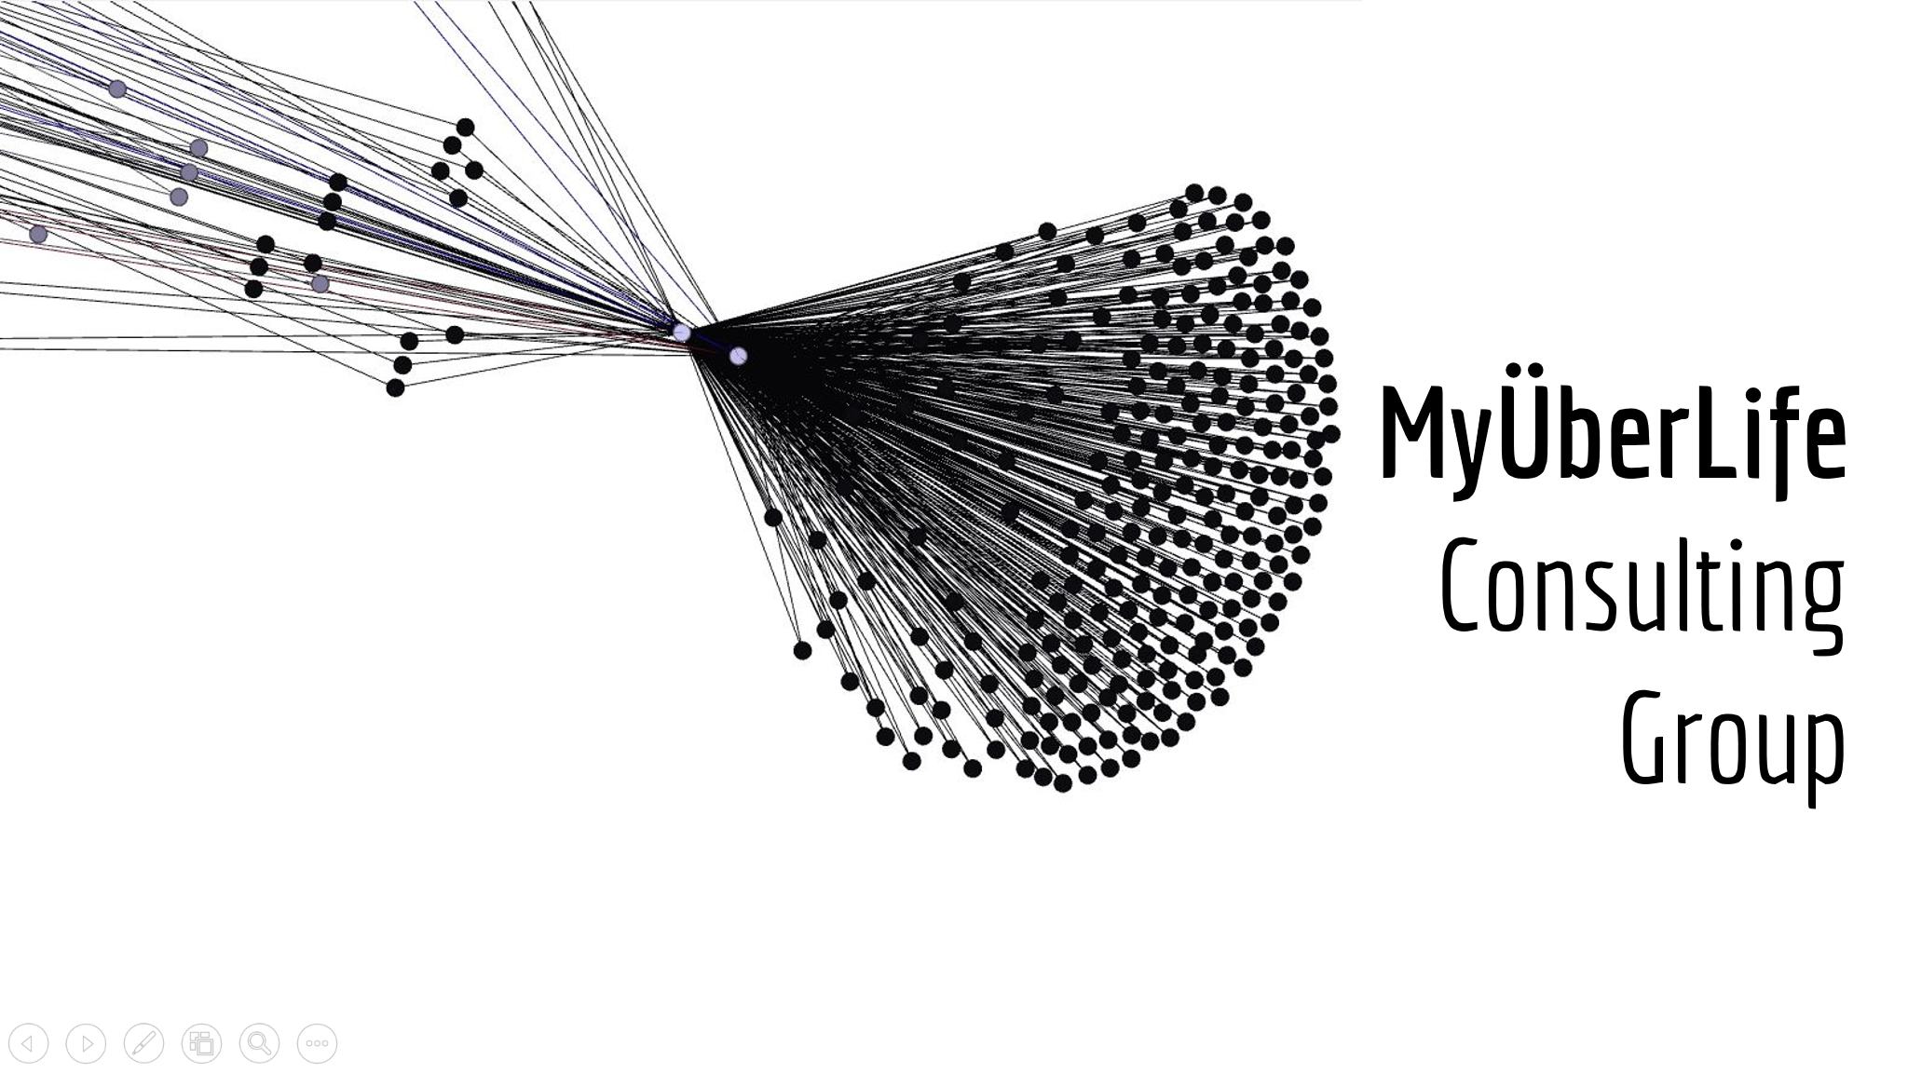
Community Detection

Slide 21
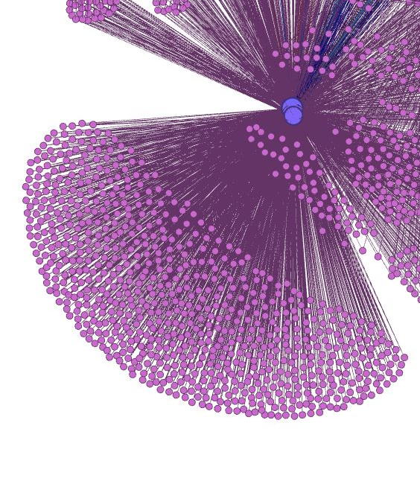
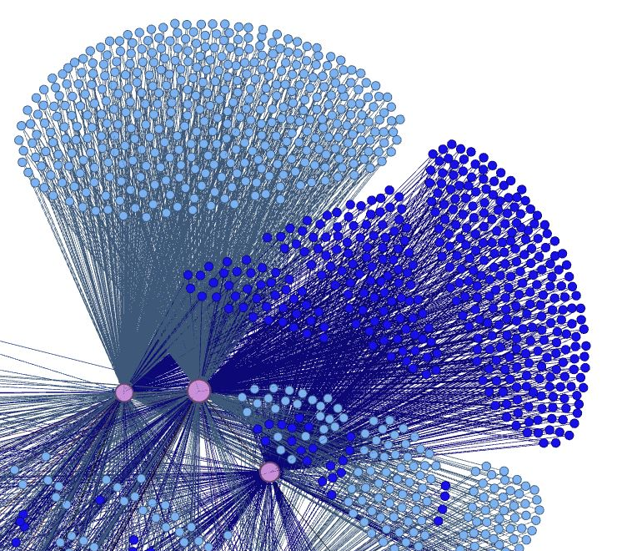
Using Personality Insights and content analysis, we try to find the difference between two communities.

Slide 22
Nodes in Blue Group VS. Nodes in Purple Group

Slide 23
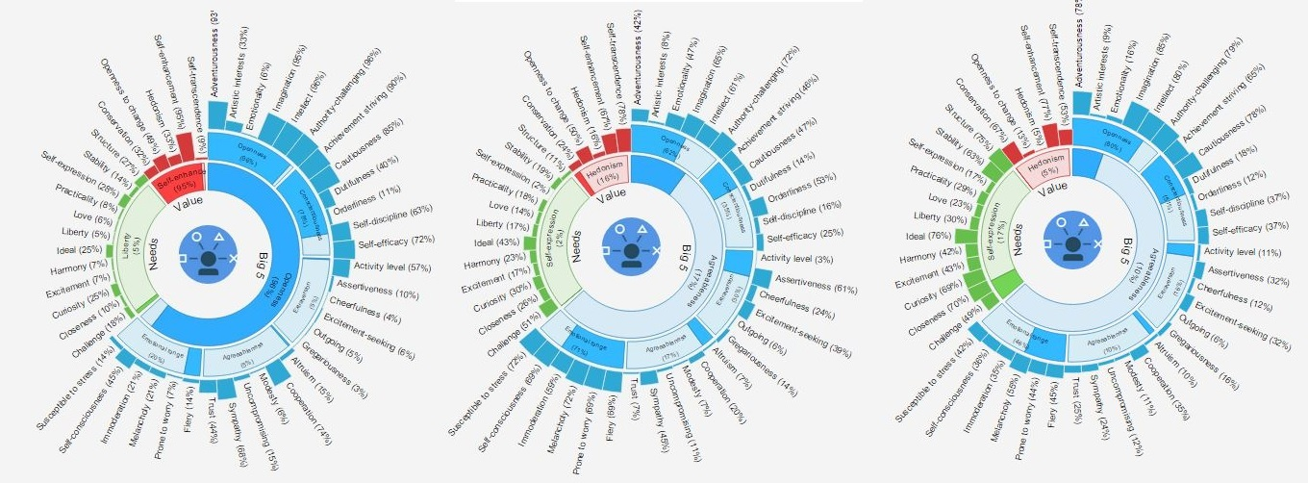
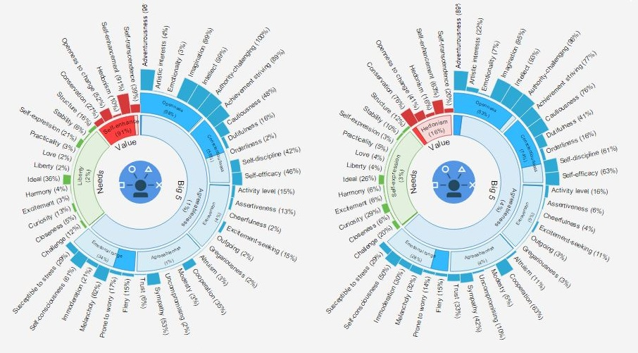
Personality Insight
Blue
Purple
Different cognitive and social characteristics between and within communities.

Slide 24
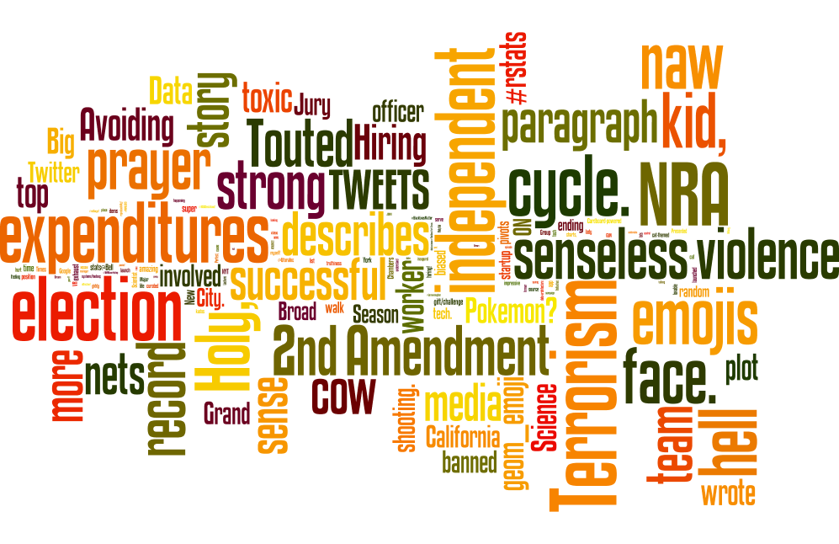
Content Analysis
Blue

Slide 25
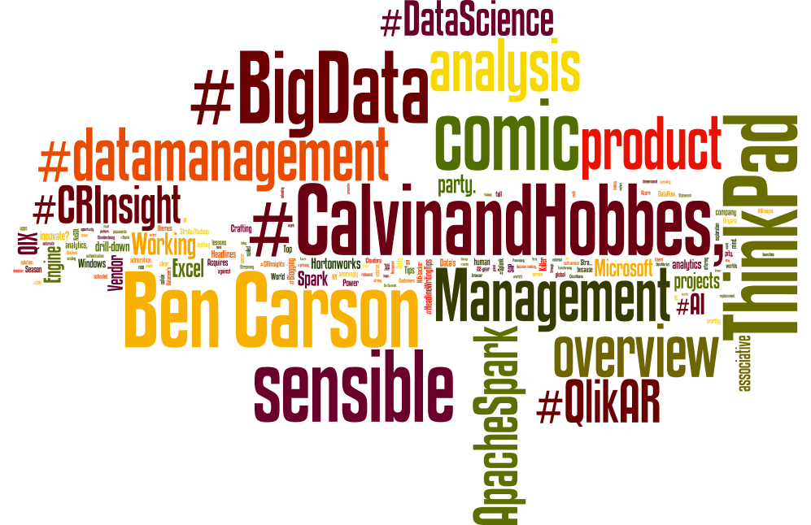
Content Analysis
Purple

Slide 26
Conclusion

Slide 27
Conclusion:
Data Science Community Is tightly woven
Sentimental Factor Doesn’t Affect Influence (Page rank)
Tweets Content Matters in Influence (Page rank)
Data relevant VS. data irrelevant
Tweets Content Matters to differentiate groups
Work related VS. life related
Limitation:
Limit amount Of Data
ONE Degree Community Network

Slide 28
Thank you for Listening Questions?

